Slide 1
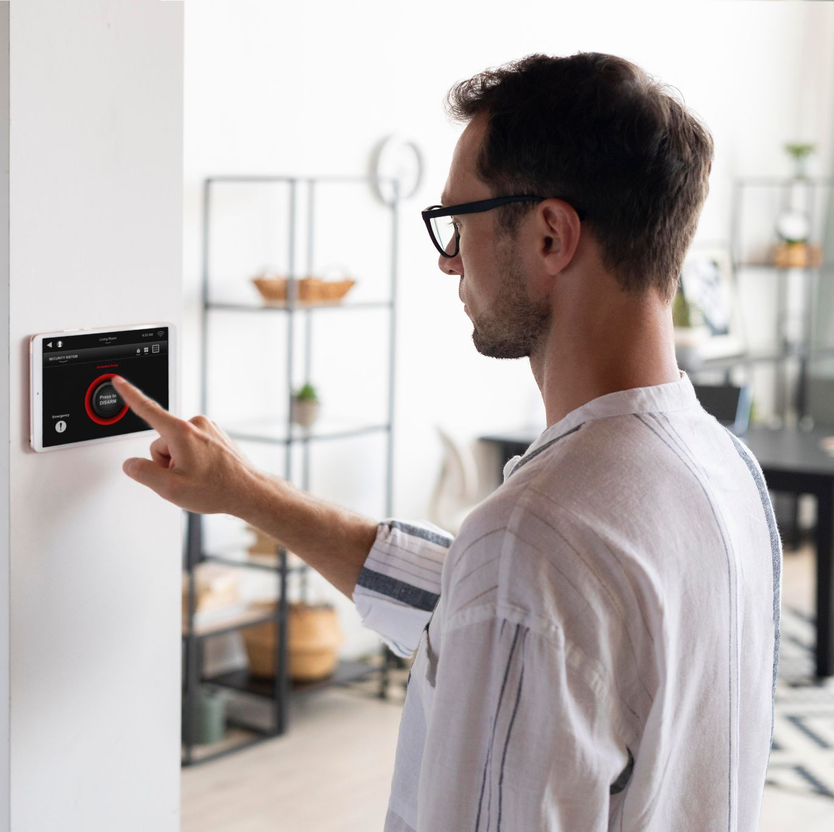
SMART HOME GRADUATION PROJECT
Made by Amit students

Slide 2
TABLE OF CONTENTS
LOGIN SYSTEM
USERS
01
03
FUNCTIONALITY
02
How login system works
What admin and normal capable to do
What the system can actually do

Slide 3
01.
LOGIN SYSTEM

Slide 4
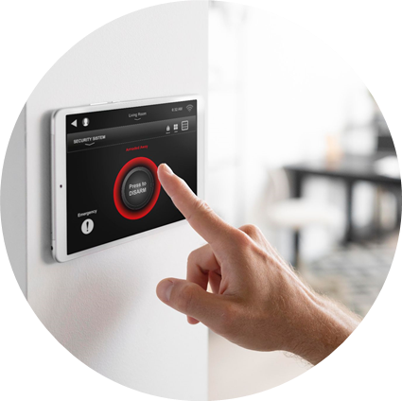
The login system is so smart that it actually identify where you login for the first time or not, if so it ask you to sign up.
If you already have an account it ask you to enter it.
You only has 3 chances to enter the right account, if you put it wrong in all the system will close and alarm will lunch!

Slide 5
So now, any user can take critical operations?
Absolutely no there is admins and normal users and we will know more about them in the next slides.
Note:
The remoted mode is for admin only and the user is using the integrated hardware.

Slide 6
02.
FUNCTIONALITY

Slide 7
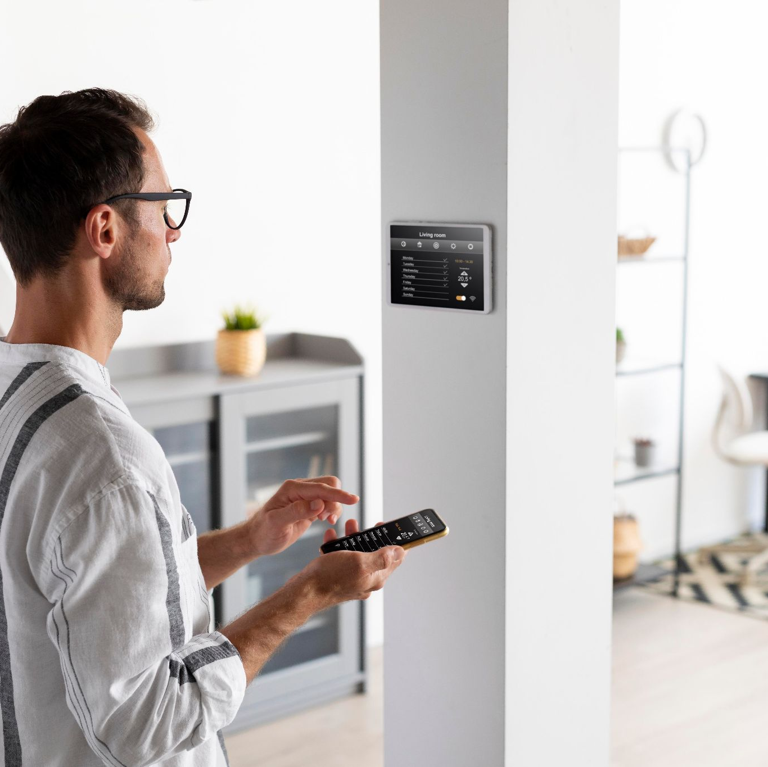
The system is remoted controlled by lab top software, but for emergency purpose you can use the LCD and keypad at the “user mode only”.
The controllable things are 6 lamps (5 on/off lamps, one dimming lamp), door and air-condition according to the ambient temperature.

Slide 8
03.
USERS

Slide 9
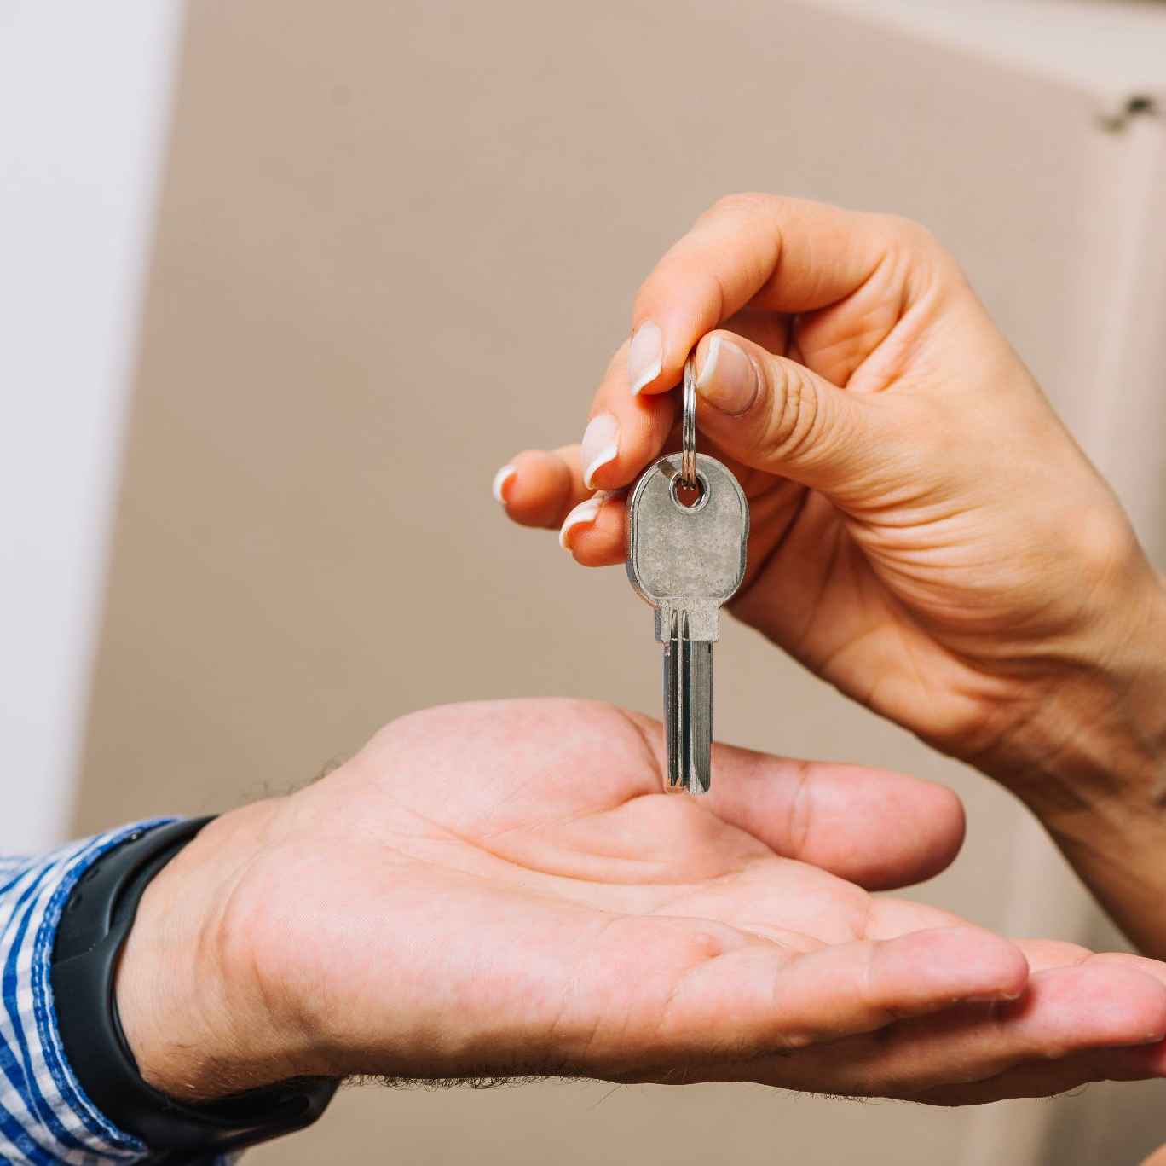
Admin mode can register any user or remove
Admin and normal user can access to all applies except normal user cannot control the door opening.
Don’t worry usernames and passwords is be kept into memory even if the system is powered off!

Slide 10
OUR TEAM
Youssef Mohamed
Alaa Amr
Eyad Medhat
Mazen Nagy
Youssef
Reda
Youssef Abosrewa

